Slide 1


ICT 171 Assignment - 2
Cloud Project
Food Ordering Website
Name : Gilchrist Candido Tavares
Student ID : 35011841
Domain name : www.gilfoodiehub.live
IP : 20.212.23.244

Slide 2
Table of Contents
No2 | Topic | Page
1 | Creating the server | 1
2 | Connecting to the server | 1
3 | Installing Necessary Modules | 1
4 | Creating the domain | 2
5 | Configuring SSL | 3
6 | Setting up the Database | 5
7 | Configuring the main server | 8
8 | Adding items to the database | 9
9 | Source Code Explanation | 10
10 | Additional Notes and Resources | 27
11 | References | 28

Slide 3
Creating the Server
Create an Ubuntu Instance on AWS, Azure, etc, with a minimum of 1 CPU and 1 GB RAM
Open ports 22,80,443 to allow SSH HTTP(S) traffic to your server.
Note the public IP address
Download the ssh-key pair file on your system
Connecting to the Server
To connect to our server, we'll use OpenSSH, available in most Windows Systems. The command is :
Installing Necessary modules
Our Server uses nginx to route traffic to our local server with SSL, NodeJS runtime to host our Express.js Server
To confirm the installation, the following commands should return the version of the package installed
To download our project code, we use git to clone our Github repository. After navigating into the folder, we use npm to install our project dependencies (express.js, supabase.js)
We also use pm2, which is a process manager for Node.JS, to ensure our server is running and log any errors
ssh –i 'path/to/file' username@public-ip
sudo apt update
sudo apt install nginx snapd git
sudo snap install node --classic
nginx -v git --version
node -v snap --version
git clone https://github.com/Agentgilspy/Food-Ordering-Website
cd Food-Ordering-Website
npm install
sudo npm install pm2 -g # pm2 -v to confirm the installation

Slide 4
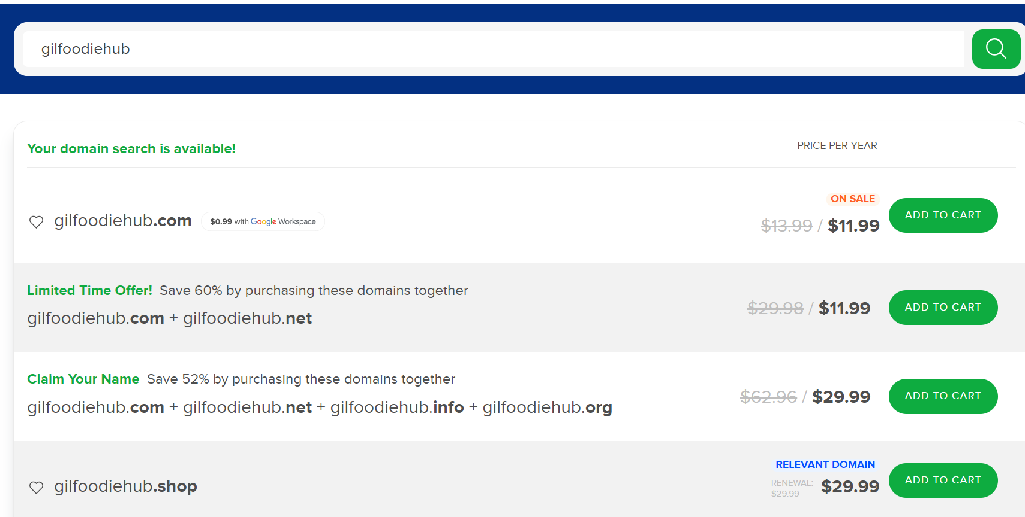
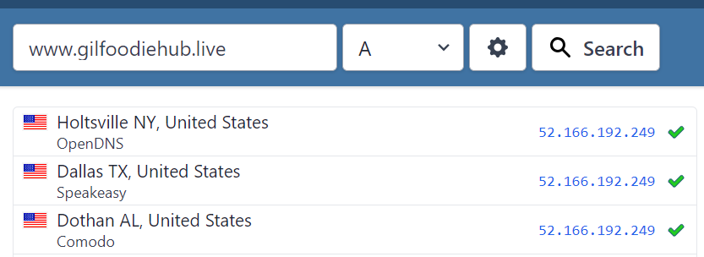
Creating the domain
I have decided to use name.com for this project, but the procedure should be similar across all DNS providers
Go to name.com, search for the desired domain, and purchase it
After purchasing the domain, go to My Domains
Go to your domain settings > Manage DNS records
Add a type A record, leaving the host field blank, and enter your IP in the answer field
www.gilfoodiehub.live will now point to our IP (52.166.192.249)
DNS records can take up to a few hours to update. We can use www.whatismydnsnet to perform a lookup on multiple name servers

Slide 5
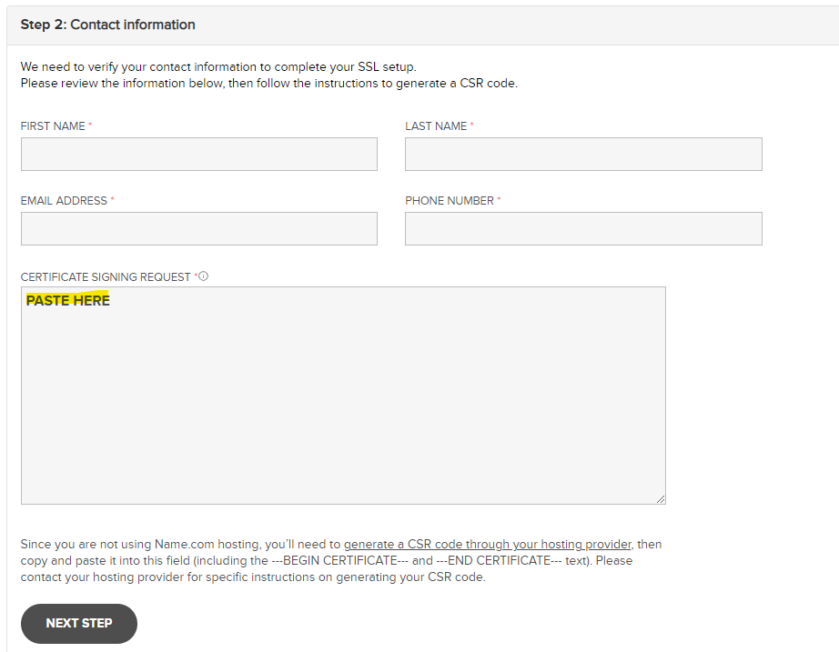
Configuring SSL
We use OpenSSL to generate our SSL key and certificate signing request(CSR), which we provide to our domain provider to get a signed SSL certificate
In our project folder, we create an SSL folder and navigate into it. Then, we use the following commands to generate the key and CSR file
You will be asked to fill in some details while generating a CSR
Using the cat command, you need to copy the contents of domain.csr
For this project, I was using Name.com, which offers an option to generate SSL certificates
Paste the contents of domain.csr in the form and fill in the details
Name.com will provide you with the contents of your certificate file. You need to copy and paste it into our server. The file should look like this
-----BEGIN CERTIFICATE REQUEST-----
STUFF HERE
-----END CERTIFICATE REQUEST-----
mkdir ssl
cd ssl
openssl genrsa -out privkey.key
openssl req -key privkey.key -new -out domain.csr
cat domain.csr
nano domain.crt # Paste the content and save the file

Slide 6
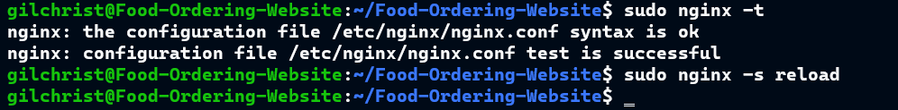
Configuring SSL
To configure nginx to use our SSL files, we need to create a config file
To confirm our config has no errors and to reload nginx so it can use our config, we need to run the following commands
cd /etc/nginx/conf.d/
sudo nano server.conf
#Paste the following
server {
listen 443 ssl;
server_name gilfoodiehub.live;
# Path may vary
ssl_certificate /home/gilchrist/Project/ssl/domain.crt;
ssl_certificate_key /home/gilchrist/Project/ssl/privkey.key;
# Our Express server is running on port 3000
# so we use nginx reverse proxy feature to route
# connections from port 443 to 3000
location / {
proxy_pass http://127.0.0.1:3000;
}
}
# The Following block redirects http to https
server {
listen 80;
server_name gilfoodiehub.live;
location / {
return 301 https://gilfoodiehub.live;
}
}
sudo nginx -t # Should Respond with a success message
sudo nginx -s reload

Slide 7
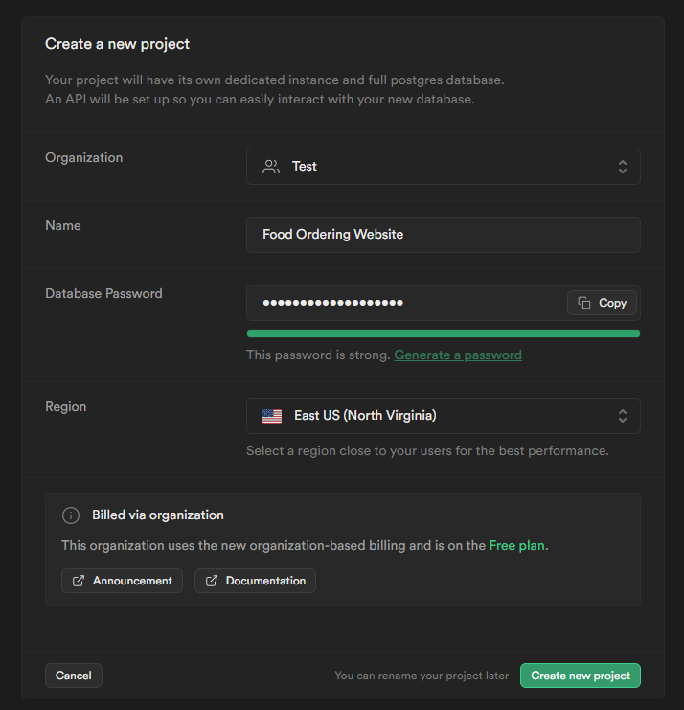
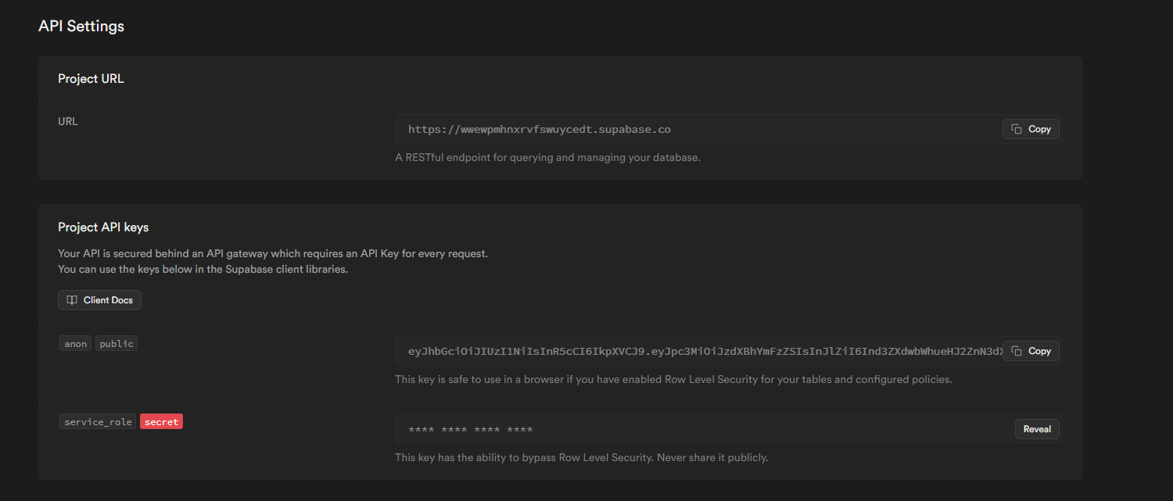
Setting up the Database
For this project, I have decided to use Supabase as a database. It is an open-source PostgreSQL database, and there is an option to host the database locally, but due to the performance requirements, it would not be cost-effective to run the database ourselves at a small scale, so I have decided to use Supabase's free tier
Create an account with Supabase, create a new project
After creating the project, go to the Project Settings > API
You must note the URL, public key, service role, and JWT secret. These are essential to allow client and server interactions with the database. These values will be stored in a config file
To create the tables that store our data, Go to SQL Editor. You will find a panel that will let you run SQL commands, and we will use this to create our tables. You can also use the UI to create the tables, which is what I did, but running the commands is faster
It is required that the commands are run in the same order as they are displayed

Slide 8
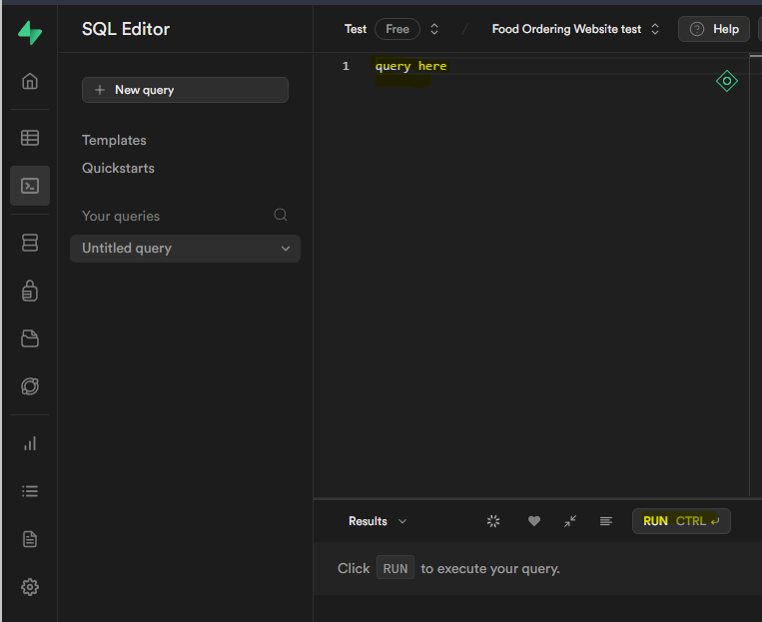
Setting up the Database
create table
public.users (
uid uuid not null,
email character varying not null,
full_name character varying not null,
phone_num character varying not null,
constraint users_pkey primary key (uid),
constraint users_uid_fkey foreign key (uid) references auth.users (id) on update cascade on delete cascade
) tablespace pg_default;
create table
public.menu (
item_id text not null,
item_name character varying not null,
type character varying not null,
description character varying not null,
price numeric not null,
image character varying null,
constraint menu_pkey primary key (item_id)
) tablespace pg_default;
create table
public.orders (
order_id bigint generated by default as identity,
uid uuid not null,
"placedAt" timestamp with time zone not null default now(),
cart json not null,
address text not null,
status numeric not null default '1'::numeric,
constraint orders_pkey primary key (order_id),
constraint orders_uid_fkey foreign key (uid) references users (uid) on update cascade on delete cascade
) tablespace pg_default;

Slide 9
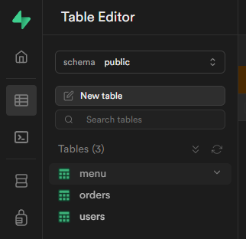
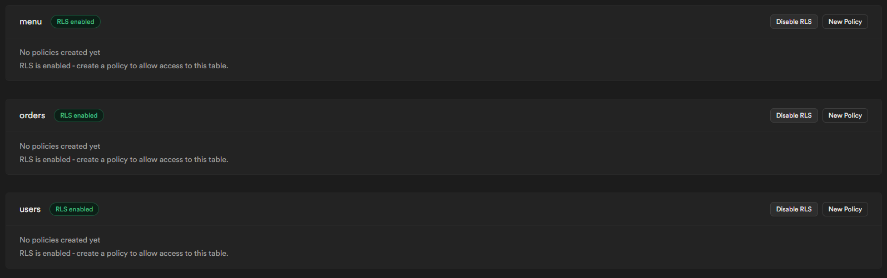
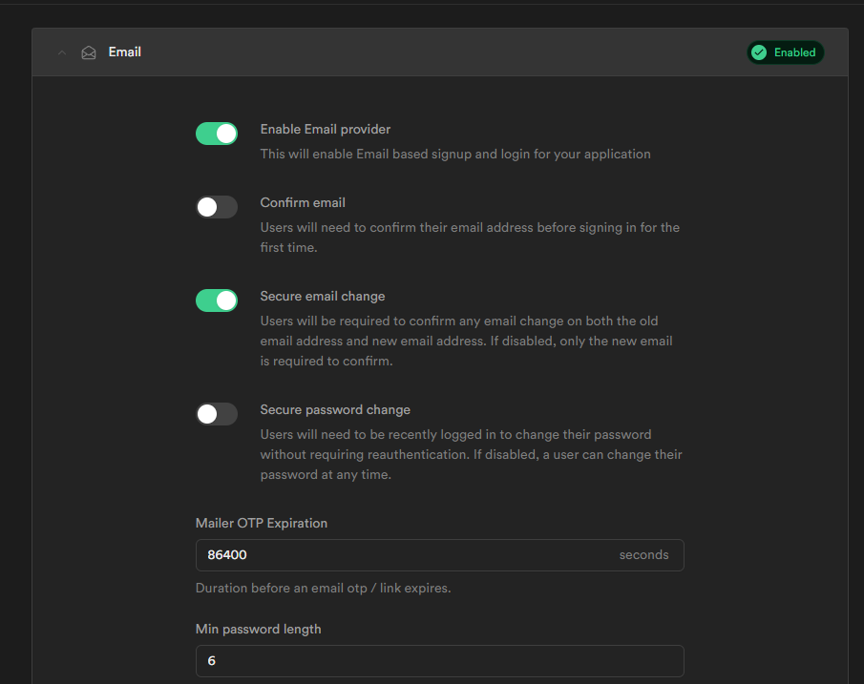
Setting up the Database
To confirm that the tables were created, go to Table Editor, and the tables should be there
We need to enable Row Level Security, a feature that prevents clients from gaining full access to the database. Under Authentication > Policies, Enable RLS for all tables, and it should look like this
To allow users to create accounts with us, we need to enable email authentication, which can be found under Authentication > Providers > Email and enable email provider. Your settings should look like this

Slide 10
Configuring the main server
I have used a config.json, supabase.js file to store my project URL, public key, service role, and port, as it is easier to update a config file rather than the code
In the root directory of the project, run the following commands to edit the config files and paste the project URL, public key, service role, and JWT secret in the ""
To initiate the server and save it in the process list and ensure
PM2 should respond with a success message. PM2 ensures our server is running 24/7. Even when the VM reboots, the application logs can be monitored using.
If the server is running, this should be your output
The server also logs actions like account order creations.
nano config.json
{
"port": 3000,
"supabase_url": "",
"supabase_service_role": "",
"jwt_secret": ""
}
nano supabase.js
pm2 start app.js
pm2 startup # Follow the steps
pm2 save
pm2 logs app

Slide 11

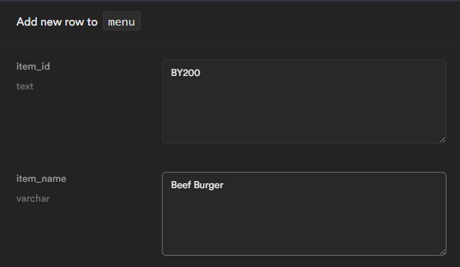
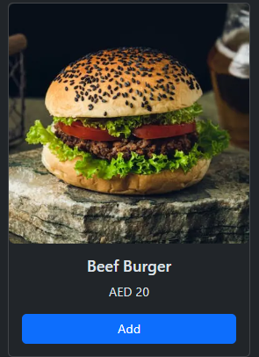
Adding Items to the menu
We will be using the Supabase table editor to add items to our menu
Go to the Project dashboard > Table Editor > Menu table and Insert a new row
Fill in the details of the item you want to add, then save it. The item will show up on the menu on refresh

Slide 12
Source Code Explanation
This project uses HTML, CSS (Bootstrap), Javascript for the frontend and NodeJS , and Supabase (database) for the backend
The text followed by // is ignored by JS as it is a comment, I will be using this to explain my code
app.js (Backend API Server)
// Importing dependencies
const express = require('express')
const { createClient } = require('@supabase/supabase-js')
const { randomInt } = require('crypto')
const jwt = require('jsonwebtoken');
const path = require('path')
// Importing config from config.json
const { supabase_url, supabase_service_role, jwt_secret, port } = require('./config.json')
// Initializing our express server and supabase client
const app = express()
const client = createClient(supabase_url, supabase_service_role)
app.use(express.json())
app.use(express.static('public'))
app.listen(port, () => {
console.log(`Server Running on port ${port}`)
})
// File endpoints , sends html files to the user whenever they go
// to domain.com/endpoint ....
// process.cwd() returns the current directory in which NodeJS is running
// path.join() takes in arguments and returns a path (/home/ubuntu/.....)
app.get('/', (req, res) => {
res.sendFile((path.join(process.cwd(), 'public', 'index.html')))
})
app.get('/menu', (req, res) => {
res.sendFile(path.join(process.cwd(), 'public', 'user', 'menu.html'))
})
app.get('/contact', (req, res) => {
res.sendFile(path.join(process.cwd(), 'public', 'user', 'contact.html'))
})
app.get('/cart', (req, res) => {
res.sendFile(path.join(process.cwd(), 'public', 'user', 'cart.html'))
})
// There is more that follows the same format, but i have not included it

Slide 13
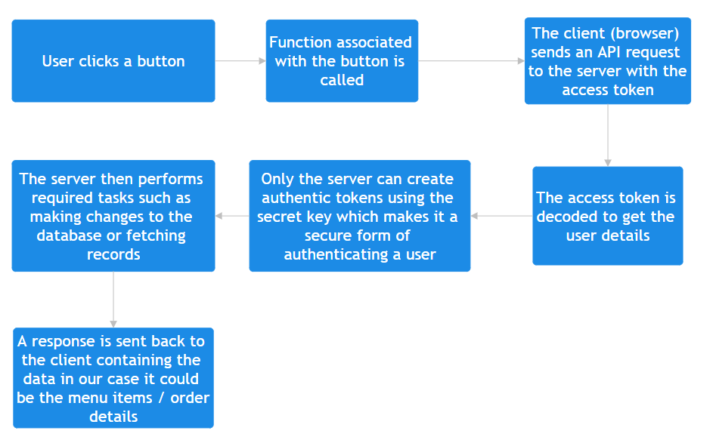
Client-Server Interaction
Explaination

Slide 14
// Function to decode access tokens from the clients
// and verify that they are authentic
function decodejwt(token) {
// Gives an Error when invalid tokens are used
// Returns { email , userid }
try {
const { email, sub } = jwt.verify(token, jwt_secret)
return { email, uid: sub }
} catch (error) {
throw Error('Invalid Token')
} }
// Whenever a new account is created a
// post request is sent with details in the body
app.post('/createuser', async (req, res) => {
try {
const { access_token } = req.query
if (!access_token) throw Error('No Access token Provided')
const { uid, email } = decodejwt(access_token)
const { full_name, phone_num } = req.body
// A new record is added in the database
await client
.from('users')
.insert({ uid, email, full_name, phone_num })
// Server logs whenever a new user is created
console.log(`New User ( ${email} ) created`)
res.status(200).send('User created')
} catch (error) {
res.status(500).send(error.message)
}
})
app.get('/menuitems', async (req, res) => {
try {
// Fetches the menu items from the database and sends it back as the response
const { data } = await client
.from('menu')
.select()
res.status(200).json(data)
} catch (error) {
res.status(500).send(error.message)
}
})

Slide 15
// Whenever the user clicks the create order button
// A post request is made to the /createorder endpoint
app.post('/createorder', async (req, res) => {
try {
// Gets the cart , addresss .. from the request body
const { cart, address, uid, email } = req.body
const order_id = randomInt(1000000, 9999999) // Random num generator
const status = 1 // Default order status which is ( Order has been Placed)
// Inserts the record into the database
const { error } = await client
.from('orders')
.insert({ order_id, uid, cart, status, address, })
if (error) throw error
// Converts the cart into a string format, which is then logged in the format
// 2 x Food Name......
let cartSummary = ''
const items = Object.keys(cart)
for (const item of items) {
cartSummary += `${cart[item]['quantity']} x ${cart[item]['item_name']}\n`
}
// Logs whenever a user makes an order
console.log(`${email} has just placed an order for\n${cartSummary}` + `OrderID: ${order_id}\nAddress: ${address}`)
// Responds with code 200 and the order id
res.status(200).json({ order_id: 10000 })
} catch (error) {
// If there's an error, the server responds with 500 and an error message
res.status(500).send(error.message)
}
})
app.get('/vieworders', async (req, res) => {
try {
const { access_token } = req.query
if (!access_token) throw Error('No Access token Provided')
const { uid } = decodejwt(access_token)
const { data } = await client.from('orders')
.select('order_id , placedAt , cart , status')
.eq('uid', uid)
// Gets the records in which the userid is the same user that made
// the request so only they can see their orders
res.json(data)
} catch (error) {
res.status(500).send(error.message)
}
})
13

Slide 16
Website Navbar
<nav class="navbar navbar-expand-lg bg-body-tertiary">
<div class="container-fluid">
<a class="navbar-brand h1 fs-4 m-0" href="/">GilFoodieHub</a>
<button class="navbar-toggler" type="button" data-bs-toggle="collapse" data-bs-target="#navbarSupportedContent">
<span class="navbar-toggler-icon"></span>
</button>
<div class="collapse navbar-collapse " id="navbarSupportedContent">
<ul class="navbar-nav me-auto mb-2 mb-lg-0 px-5">
<li class="nav-item fw-medium fs-5 ">
<a class="nav-link active fw-medium" aria-current="page" href="/">Home</a>
</li>
<li class="nav-item fw-medium fs-5">
<a class="nav-link" aria-current="page" href="/menu">Menu</a>
</li>
<li class="nav-item fw-medium fs-5">
<a class="nav-link" aria-current="page" href="/trackorder">Track Order</a>
</li>
<li class="nav-item fw-medium fs-5">
<a class="nav-link" aria-current="page" href="/contact">Contact</a>
</li>
</ul>
<div class="d-flex ">
<a class="nav-link px-2" aria-current="page" href="/cart">
<img class="img-fluid" src="/assets/cart.svg" width="40" height="40">
</a>
</div>
</div>
</div>
</nav>

Slide 17
Menu Page
window.onload = async () => { // Function runs on window load
// Gets the login session of the user
await getSession()
try {
// API request to our /menuitems endpoints and
// gets all the items in an Array []
const data = (await (await fetch('/menuitems')).json())
document.getElementById('loadingicon').remove()
const item_list = document.getElementById('item-list')
for (const item of data) {
// Iterates through the Array runs the create card
// function on each item
item_list.innerHTML += createCard(item)
} } catch (error) {
alert(error)
console.error(error) }}
function increaseQty(button) {
// Button to increase the quantity
// Gets the input element and increments its value, no values above 50
const input = button.parentElement.getElementsByTagName('input')[0]
if (input.value == 50) return
input.value = parseInt(input.value) + 1 }
function decreaseQty(button) {
// Same as increaseQty
const input = button.parentElement.getElementsByTagName('input')[0]
if (input.value == 1) return // To avoid negative
input.value = parseInt(input.value) - 1}
// Function to add items to the cart from the menu
function addCart(button) {
// Gets the variables which are stored in the button id
// and qty from input element
const [item_id, item_name, price, image] = button.id.split('&') const qty = button.parentElement.getElementsByTagName('input')[0].value
// The cart is stored in the browser's local storage in the form of JSON
// The following code just adds entries to the JSON object
let cart = localStorage.getItem('cart')
if (!cart) cart = {}
else cart = JSON.parse(cart)
if (cart[item_id]) {
cart[item_id]['quantity'] += parseInt(qty)
} else {cart[item_id] = {
item_name,
quantity: parseInt(qty),
price: parseFloat(price),
image,}}
// Sets the item in localstorage
localStorage.setItem('cart', JSON.stringify(cart))
}
15

Slide 18
function createCard(item) {
// The function takes an item object with properties like itemname, // price, qty. and using template literals, the function returns the html // for each menu item, which is then inserted into the browser
// The for loop in the previous segment calls this function which then adds // the html to the page
return ` <div class="col-3 gy-3" >
<div class="card">
<img src="${item.image}" class="card-img-top rounded-3 " >
<div class="card-body text-center">
<h5 class="card-title">${item.item_name}</h5>
<p class="card-text">AED ${item.price}</p>
<button class="btn btn-primary w-100" data-bs-toggle="modal" data-bs-target="#${item.item_id}">Add</button>
<div class="modal fade" id="${item.item_id}" tabindex="-1">
<div class="modal-dialog">
<div class="modal-content">
<div class="modal-header">
<button type="button" class="btn-close" data-bs-dismiss="modal"></button></div>
<div class="modal-body">
<div class="container-fluid">
<div class="row">
<div class="col">
<img src="${item.image}" class="card-img-top rounded-3 w-75"></div>
</div>
<div class="row py-3">
<h1 class="modal-title fs-5 text-center w-100">${item.item_name}</h1>
</div>
<div class="row"><p>${item.description}</p></div></div></div>
<div class="modal-footer">
<div class="input-group mb-3">
<button class="btn btn-outline-secondary" onclick="decreaseQty(this)" type="button">-</button>
<input class="form-control" type="number" value="1" min="1" readonly>
<button class="btn btn-outline-secondary" onclick="increaseQty(this)" type="button">+</button>
<button id='${item.item_id}&${item.item_name}&${item.price}&${item.image}' type="button" class="btn btn-primary mx-1" onclick="addCart(this)" data-bs-dismiss="modal">
Add to cart</button></div></div></div></div></div></div></div></div>
`}

Slide 19
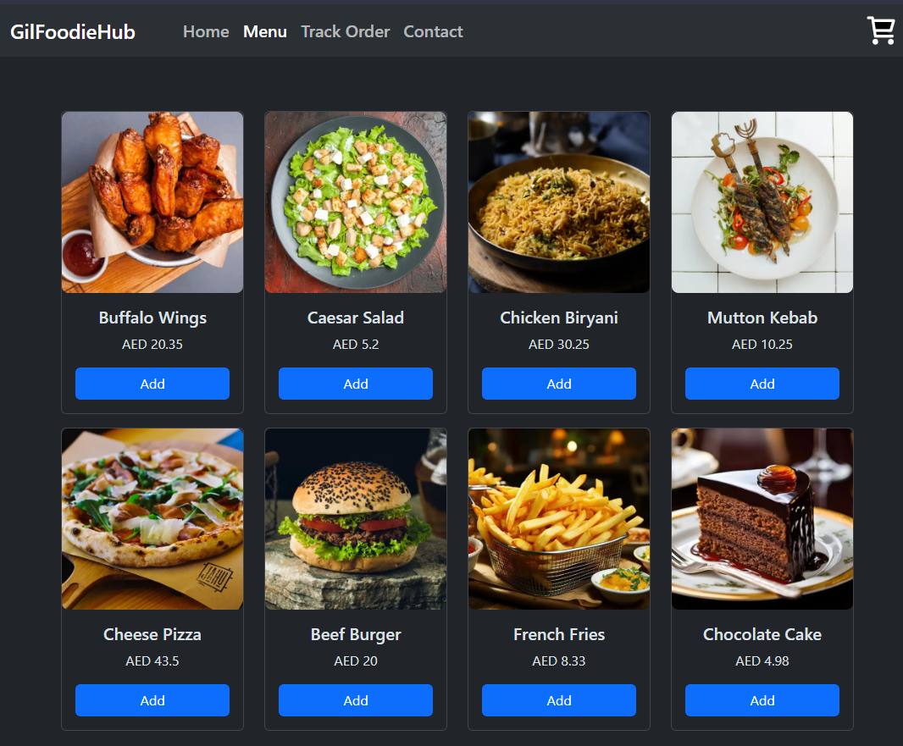
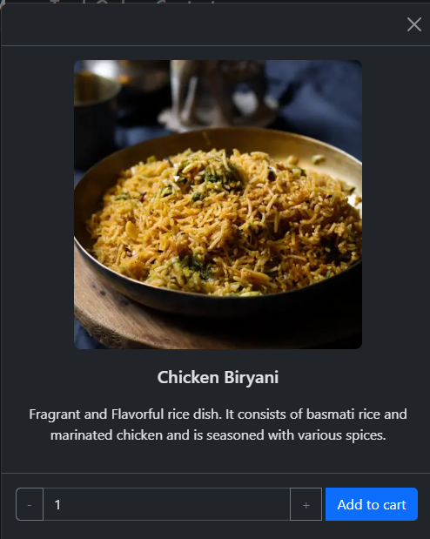
The website sents a API request to the server asking for the menu details
The server responds with an Array containing the menu items
[{
"item_id": "BW200",
"item_name": "Buffalo Wings",
"type": "Appetizers ",
"description": "Hot Spicy Chicken Buffalo wings coated with our signature sauce",
"price": 20.35,
"image": "/assets/BW200.webp"
}, ........ etc ]
The code loops through the Array , and runs the createCard function on each element in the Array which uses uses DOM Manipulation ( Modifying the HTML using Javascript ) to insert the cards.
This way we don't have to hard code the menu items into the HTML but can use the database to store the menu items
Each card his its own modal which is like a popup that is used here to let the user input the quantity and add to cart

Slide 20
Cart Page
window.onload = async () => {
await getSession()
const tablebody = document.getElementById('item-list')
// Fetching the cart from local storage , which was made in the menu page
let cart = localStorage.getItem('cart')
// Making cart an empty object instead of null to avoid errors
cart = JSON.parse(cart) || {}
const item_ids = Object.keys(cart)
// Using DOM manipulation to remove the empty cart message
// and show the actual cart table
if (item_ids.length == 0) {
document.getElementById('empty-cart-msg').hidden = false
document.getElementById('main-table').hidden = true
}
for (const item_id of item_ids) {
// Using the spread operator so i can also add item_id along with the item object
tablebody.innerHTML += createRow({ item_id, ...cart[item_id] })
}
// Brings the total price row to the end of the table
const totalprice = document.getElementById('totalprice')
tablebody.append(totalprice)
updateTotal()
}
function createRow({ item_id, item_name, quantity, image, price }) {
// Using DOM Manipulation to insert the Table rows for our cart
return `
<tr >
<th scope="row"><img src="${image}" height="60"></th>
<td class=" align-middle"><h6 class="m-0">${item_name}</h6></td>
<td class="text-center align-middle">
<div class="input-group align-items-center justify-content-center">
<button id="${item_id}_decrease" class="btn btn-outline-secondary rounded-2"
onclick="decreaseQty(this)" type="button">-</button>
<input class="form-control rounded-1" type="number" value="${quantity}" min="1" readonly>
<button id="${item_id}_increase" class="btn btn-outline-secondary rounded-2"
onclick="increaseQty(this)" type="button">+</button></div></td>
<td class="text-center align-middle" id="${item_id}_price">AED ${quantity * price}</td>
<td class="text-center align-middle">
<button id='${item_id}_remove' type="button"class="btn btn-danger mx-1 " onclick="cartRemove(this)">Remove</button>
</td></tr> `}

Slide 21
function increaseQty(button) {
// Gets the item id from the elementid then gets the qty value from the // input element Adds 1 to it
const [item_id] = button.id.split('_')
const input = button.parentElement.getElementsByTagName('input')[0]
let qty = parseInt(input.value)
qty += 1
if (qty >= 50) return;
input.value = qty + 1
// Fetches the cart from the localstorage then updates the quantity
let cart = localStorage.getItem('cart')
cart = JSON.parse(cart)
cart[item_id]['quantity'] = parseInt(qty)
localStorage.setItem('cart', JSON.stringify(cart))
// Updating the total price to match the quantity
const total = `AED ${qty * cart[item_id]['price']}`
const pricerow = document.getElementById(`${item_id}_price`)
pricerow.innerText = total
updateTotal()
} function decreaseQty(button) {} // Same as increaseQty but – instead of +
function cartRemove(button) {
const [item_id] = button.id.split('_') // Fetches the cart from localstorage and deletes the item from it
let cart = localStorage.getItem('cart')
cart = JSON.parse(cart)
delete cart[item_id]
localStorage.setItem('cart', JSON.stringify(cart))
// Removes the table row of the item
button.parentElement.parentElement.remove()
// Updating the total price
updateTotal() }
function updateTotal() {
// Gets the elements which display the total prices
const finaltotalprice = document.getElementById('final_total_price')
const totalprice = document.getElementById('total_price')
// Fetches the cart and iterates through all the items
// (price & quantity) to calculate the total sum
let sum = 0
let cart = localStorage.getItem('cart')
cart = JSON.parse(cart) || {}
const item_ids = Object.keys(cart)
for (const item_id of item_ids) {
const { price, quantity } = cart[item_id]
sum += price * quantity
}
totalprice.innerText = `AED ${sum}`
finaltotalprice.innerText = `Total Price: AED ${sum}` }
19

Slide 22
async function placeorder(button) {
// Gets the credit card and address from the input elements
// The Credit card infois not processed here, its just used as an payment example
const creditcard = document.getElementById('creditcard').value
const address = document.getElementById('deliveryaddress').value || 'Default '
// We use a loading effect here since sending requests to the server
// will take time
const loadingicon = document.getElementById('loadingicon')
if (!creditcard && !deliveryaddress) return alert('Please Enter Random Details')
const cart = JSON.parse(localStorage.getItem('cart'))
button.hidden = true // Hiding the button so the user cant click it again
loadingicon.hidden = false try {
// Get the session of the current logged in user and get
// the access token of the session this is used to verify
// the identity of the user making the request on the backend
const { data, error } = await client.auth.getSession()
const { access_token } = data.session
if (error) throw error
// Sends a POST Request with access_token in the request query
// and cart and address in the request body
const { order_id } = await (await fetch(`/createOrder?access_token=${access_token}`, {
method: 'POST',
headers: {
'Content-Type': 'application/json'
},
body: JSON.stringify({
cart, address
})
})).json()
// The server should respond with the orderid which is displayed
// otherwise the code in the catch {} runs if there was an error
loadingicon.hidden = true
const successDiv = document.getElementById('successdiv')
successDiv.innerHTML = `Your order has been placed you can track it
<a href="/trackorder?order_id=${order_id}"> here</a>`
successDiv.hidden = false
localStorage.removeItem('cart') // To reset the cart
} catch (error) {
loadingicon.hidden = true
const errorDiv = document.getElementById('errordiv')
errorDiv.innerHTML = `${error.message}`
errorDiv.hidden = false
}
}
20

Slide 23
Track Order Page
// Status' are stored as numbers so we
// don't have to store the message in the database
const statusMessages = {
1: 'Order Confirmed', 2: 'Food is being prepared',
3: 'Out for delivery', 4: 'Delivered'
}
function createRow({ order_id, placedAt, cart, status }) {
// Using DOM Manipulation to add in the table row with the order details
// Converts the date object to a 00:00 AM time string
const time = new Date(placedAt).toLocaleTimeString('en-US',
{ hour12: true, hour: '2-digit', minute: '2-digit' })
let cartSummary = ''
// Makes a Cart Summary of Quantity x ItemName
const items = Object.keys(cart)
for (const item of items) {
cartSummary += `${cart[item]['quantity']} x ${cart[item]['item_name']}<br>`
}
return `<tr>
<td>${order_id}</td>
<td>${time}</td>
<td>${statusMessages[status]}</td>
<td>${cartSummary}</td>
</tr > `}
window.onload = async () => {
try {
// Gets the session of the current logged in user
const session = await getSession()
// Sends a get request to the server with access token in the request query
const res = await fetch(`/vieworders?access_token=${session.access_token}`)
const orders = await res.json() // Returns an array of orders
if (orders.length == 0) { // Checks if the orders array is empty
// Redirects to the menu if there are no orders
alert('No Active Orders')
return location = '/menu'}
// Gets the table element , loops through the array and adds the table rows
const maintable = document.getElementById('main-table')
const loadingIcon = document.getElementById('loadingicon')
const tablebody = document.getElementById('tablebody')
for (const order of orders) {
tablebody.innerHTML += createRow(order) }
maintable.hidden = false
loadingIcon.remove()
} catch (error) {
alert(error.message)
console.error(error) }}
21

Slide 24
The website stores the user's cart in local storage in the form of JSON
Whenever the user goes to the cart page the browser fetches the cart from the local storage
{
"PI100": {
"item_name": "Cheese Pizza",
"quantity": 3,
"price": 43,
"image": "/assets/PI100.png"
}, ... etc}
The code loops through each entry in the Object and creates the HTML for the table row using createRow function, which is then inserted into the table body
Each row has its own set of buttons to increase/decrease the quantity and remove the item from the cart
The updatetotal function is executed whenever there’s a change in quantity for any item in the cart. It changes the total value displayed
Whenever the user places an order, the function gets the cart and user session from the local storage
A POST request is sent to /createorder with the access token
The server processes the request and inserts a new record in the database containing the cart, userid, address , orderID,orderstatus, a success response is sent back to the client with the orderID which they can use to track their order
On the trackorder page a get request is sent to /vieworders with the user access token , the server filters out only the user’s orders and sends it back as an Array
[{ordered:23232,uid:’34324’,cart:{same as above} , status]
The function loops through the array and inserts the information from the array into table records which the user sees

Slide 25
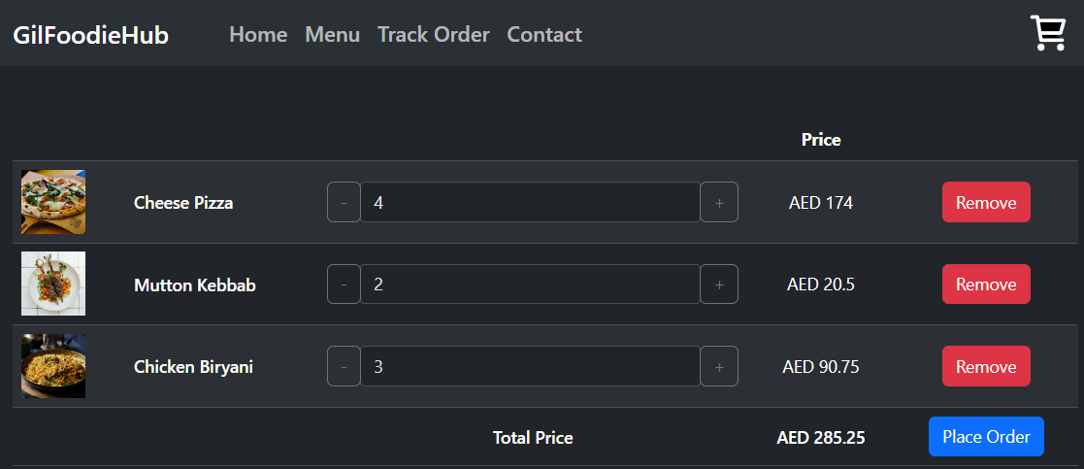
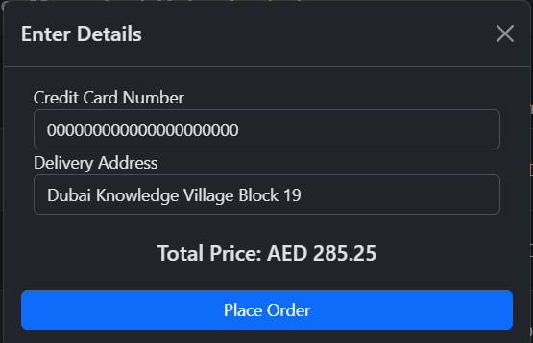
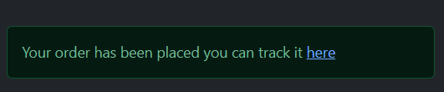
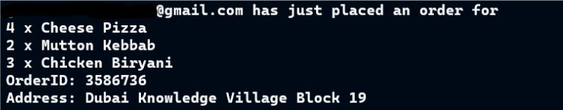
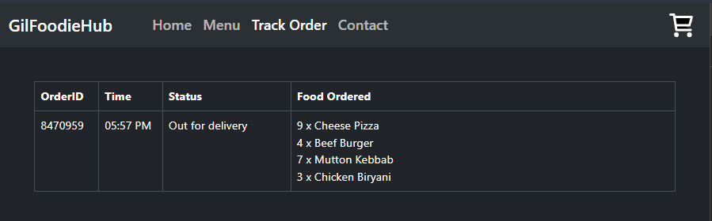
Server log

Slide 26
Login & Signup Page
let signuphtml, loginhtml;
const SUPABASE_URL = "PROJECT URL"
const SUPABASE_KEY = "SUPABASE KEY"
const client = supabase.createClient(SUPABASE_URL, SUPABASE_KEY) // Function is used on most pages
// its makes sure the user is signed in before
// Being able to access the website to avoid errors
async function getSession() {
const { data, error } = await client.auth.getSession()
const { session } = data
if (error) {
alert(error.message)
console.error(error)
return
}
if (!session) return loginmodal() return session }
// There is no dedicated page for signup
// I make use of bootstrap modal which is like a popup windows
// which shows the signup prompt
async function signupmodal() {
// Fetches the html the html from the server adds it to the document
if (!signuphtml) {
const html = await ((await (fetch('/signup'))).text())
document.body.innerHTML += html
signuphtml = true
}
// Using bootstrap to intialize and make the modal popup
const signupmodal = new bootstrap.Modal(document.getElementById('signupmodal'))
signupmodal.show()
const submitButton = document.getElementById('submit')
submitButton.onclick = async () => {
submitButton.disabled = true
// Using a form prompt to collect the userinfo const email = document.getElementById('email').value
const fname = document.getElementById('fname').value
const pwd = document.getElementById('pwd').value
const cpwd = document.getElementById('cpwd').value
const phonenum = document.getElementById('phonenum').value
// The details are processed to ensure there are no errors
if (!email.includes('@')) return alert('Invalid email')
if (pwd.length < 7) return alert('Password too short')
if (!fname) return alert('No Name Provided')
if (!phonenum) return alert('No Number Provided')
if (pwd != cpwd) return alert('Passwords do not match')
// Code continues on the next page
24

Slide 27
try { // Uses the built-in function in the supabase library
// to create signUp a new user
const { data, error } = await client.auth.signUp({
email: email,
password: pwd, }) if (error) throw error const { session } = data
// We use access tokens to verify the requests are authentic
// and send a POST request to the server to add the new
// user into the database , the user is redirected to /homepage
await fetch(`/createuser?access_token=${session.access_token}`, {
method: 'POST',
headers: {
'Content-Type': 'application/json'
},
body: JSON.stringify({
full_name: fname,
phone_num: phonenum
}) })
location.href = '/'
} catch (error) {
submitButton.disabled = false
console.error(error.message)
alert(error.message)
} } }
// The code is similar to the signupmodal
async function loginmodal() {
// Fetches the login html from the server
if (!loginhtml) {
const html = await ((await (fetch('/login'))).text())
document.body.innerHTML += html
loginhtml = true
}
const loginmodal = new bootstrap.Modal(document.getElementById('loginmodal'))
loginmodal.show() const submitButton = document.getElementById('loginsubmit')
submitButton.onclick = async () => {
const email = document.getElementById('loginemail').value
const pwd = document.getElementById('loginpwd').value
const { data, error } = await client.auth.signInWithPassword({
email: email,
password: pwd, })
if (error) {
console.error(error)
alert(error.message)
return location = '/'
}
}
25

Slide 28
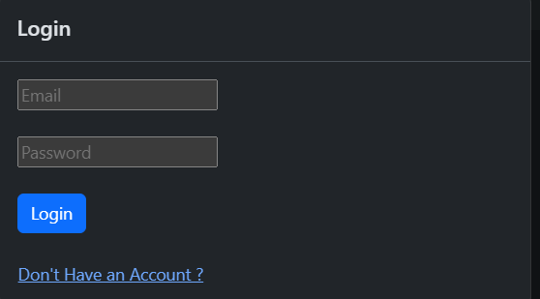
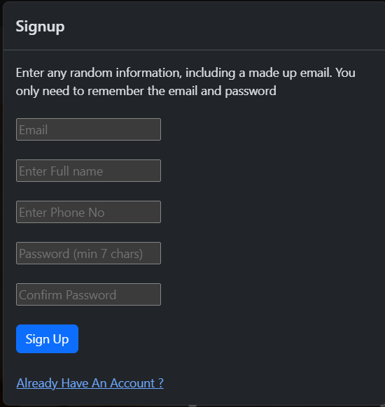

Slide 29
Additional Notes and Resources
The source code of the website and server can be found here
The full Website can be accessed here
All images were sourced from freepik.com
The Privacy Policy was generated using policy generator
I have used Bootstrap as its easier to use than raw CSS
Supabase was the database of choice due to the features it offers in its free tier
All the static code that will served to the users should be in the public folder
Any images or videos used should be stored in /public/assets
There is no Admin Section of the Page, so any changes to the database records need to be directly done from the Supabase portal
A fake email can be used without verification while testing since this project is still being developed
WinSCP is an open-source SCP client that allows you to transfer files from your local to your remote computer quickly. It is a more accessible alternative to upload files to your remote computer instead of using git clone.

Slide 30
References
[1] Bootstrap, "Getting Started with Bootstrap," n.d. [Online]. Available: https://getbootstrap.com/docs/5.3/getting-started/introduction/.
[2] Express, "Getting Started," n.d. [Online]. Available: https://getbootstrap.com/docs/5.3/getting-started/introduction/.
[3] Supabase, "Supabase DOCS," n.d. [Online]. Available: https://supabase.com/docs.
[4] DigiCert, " OpenSSL Quick Reference Guide," n.d. [Online]. Available: https://www.digicert.com/kb/ssl-support/openssl-quick-reference-guide.htm.

